Slide 1
NAPLAN
Topic: NAPLAN Prep
EQ: How else can we write big numbers?
Mrs Stretch
Year 9

Slide 2
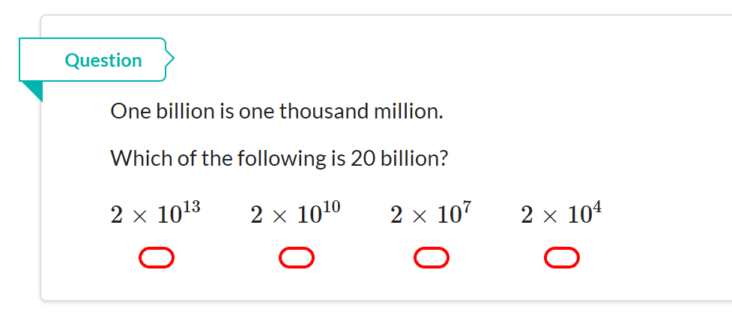
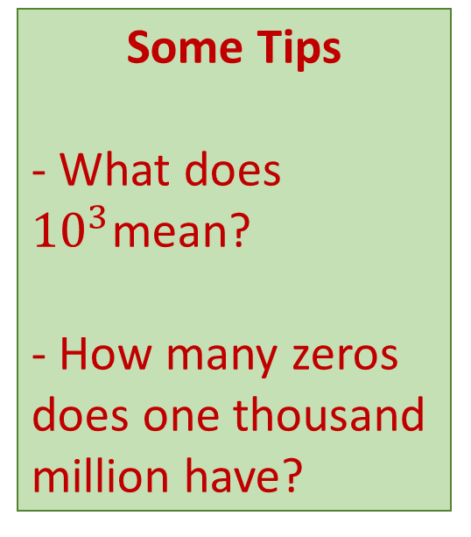
NAPLAN Question
Some Tips
- What does ${10}^{3}$mean?
- How many zeros does one thousand million have?

Slide 3
How Big??
First let’s check are understanding of very large and very small numbers.
The Cosmic Eye.
https://www.youtube.com/watch?v=jfSNxVqprvM

Slide 4
Very large numbers!
How far?
92,000,000 miles

Slide 5
Very large numbers!
Happy 70th Birthday!
How many seconds in 70 years?
70 years = 2 200 000 000 seconds!

Slide 6
Very large numbers!
Dinosaurs roamed the earth 228 million years ago

Slide 7
Short hand!
10
100 = 10 x 10
1 000 = 10 x 10 x 10
10 000 = 10 x 10 x 10 x 10
100 000 = 10 x 10 x 10 x 10 x 10
1 000 000 = 10 x 10 x 10 x 10 x 10 x 10

Slide 8
Standard Form
200 = 2 x 100
4 000 = 4 x 1000
70 000 = 7 x 10 000
500 000 = 5 x 100 000
3 000 000 = 3 x 1 000 000
This is also known as
Scientific Notation.

Slide 9
Exercise 1
2 000
(2) 20 000
(3) 500
(4) 800 000
(5) 9 000 000
= 2 x 1000
= 2 x 10 000
= 5 x 100
= 8 x 100 000
= 9 x 1 000 000

Slide 10
A short cut
Move the point to get a
number between 1 and 10
.
The point moved 6 places
8 000 000
.
Add the
decimal point
Between 1 and 10

Slide 11
A short cut
Move the point to get a
number between 1 and 10
.
The point moved 7 places
92 000 000
.
Add the
decimal point
Between 1 and 10

Slide 12
A short cut
Move the point to get a
number between 1 and 10
.
The point moved 9 places
2 200 000 000
.
Add the
decimal point
Happy Birthday: Seconds old!
Between 1 and 10

Slide 13
A short cut
Move the point to get a
number between 1 and 10
228 000 000
The point moved 8 places
.
.
Add the
decimal point
Between 1 and 10

Slide 14
Exercise 2
(1) 30 000
(2) 700 000
(3) 5 300
(4) 470 000
(5) 9 500 000
(6) 18 300 000
(7) 329 000
(8) 2 560 000
(9) 12 000 000 000
(10) 9 990 000

Slide 15
Changing back
The point moves 7 places
8.6
0000000
.
=86 000 000
Hint:
Add 7 zeros, although you probably won’t need them all.
Zeros after the point aren’t needed.

Slide 16
Changing back
The point moves 5 places
3.46
00000
.
=346 000
Hint:
Add 5 zeros, although you probably won’t need them all.
Zeros after the point aren’t needed.

Slide 17
Exercise 3
(1)
(2)
(3)
(4)
(5)
(6)
(7)
(8)
(9)
(10)
= 600 000
= 8 000
= 650 000
= 120 000 000
= 3 710 000
= 33 000
= 7 910 000
= 55 500 000
= 10 500
= 3 033 000 000

Slide 18
Name that number!
1 000
one thousand
What’s this called?
1 000 000
one million
What’s this called?
1 000 000 000
and this one?
one billion
10 000 000 000 000 000 000
000 000 000 000 000 000 000
000 000 000 000 000 000 000
000 000 000 000 000 000 000
000 000 000 000 000 000
one googal !!!
What’s this called?

